Slide 1
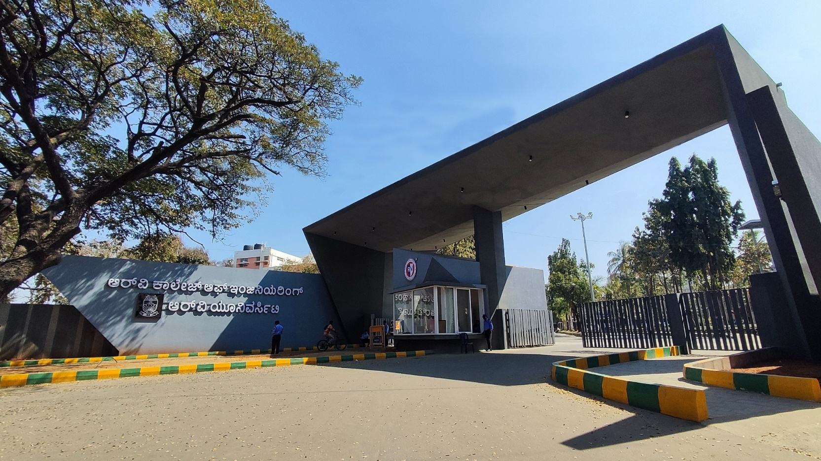
Energy Management System
Energy, 130, Urja

Slide 2
SMART ENERGY METER
Navaneeth V
Chidanand Gowda
Kamma Rohan
Bomgonda Vishal

Slide 3
Introduction
Overview of the topic:
A smart energy meter is a digital device that measures and records energy consumption in real time.
Objectives of the current phase:
To measure the reading of current and voltage consumed by electrical appliance and calculate the power .

Slide 4
Project Overview
Problem Statement:
Traditional meters provide cumulative energy usage data but fail to offer real-time insights into consumption patterns.
Inefficient energy usage contributes to higher carbon emissions, impacting sustainability goals, which can be minimized by real time tracking and analysis .
Primary objectives:
Analyze appliance-level energy consumption to detect inefficient or high-energy-consuming devices.

Slide 5
Expected impact:
Real-time energy monitoring allows users to track and control appliance usage, reducing unnecessary consumption.
Smart energy solutions enable identification of energy-hungry devices and promote efficient resource utilization.
Helps in identification of which appliances need automation based on power consumption

Slide 6



Comments during EL Phase-I and action taken
Lack of technicality in objectives and lack of details in methodology
Researched more into the specifics for implementation of project
Corrected the format of citation of research paper.

Slide 7

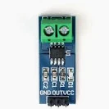
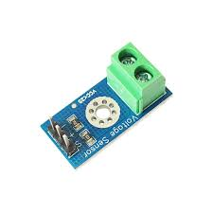
Tools and Techniques Used
Tools used:
ESP8266
Sensors (Voltage and Current)
Arduino IDE
Excel

Slide 8
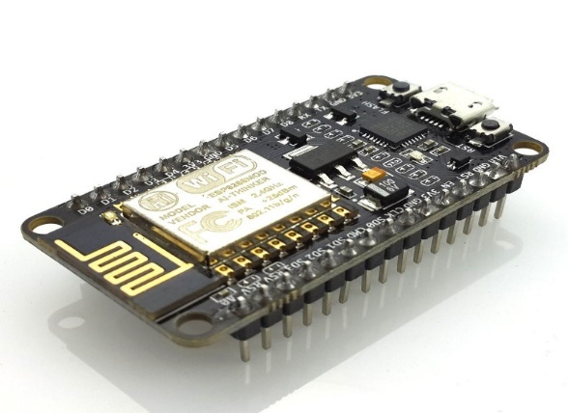
ESP8266 transmits processed data to communication modules (e.g., Wi-Fi, Bluetooth) for real-time monitoring
Excel is used to store current, voltage values.

Slide 9
Circuit diagram
Pending

Slide 10
Project Progress
Current Status of the Project:
The design phase, including conceptualization and component selection (sensors, microcontroller, communication modules), is fully completed.
A functional prototype is in place, integrating sensors with ESP8266. The system is capable of real-time data collection and monitoring.
Milestones Achieved:
The functional prototype is operational and capable of measuring current and voltage in real time.

Slide 11
Challenges faced and their solution:
Challenge: Completing the circuit diagram , The connection on the bread board with all the components.
Solution: With the help of reference videos and google to assist the wiring of the setup.
Challenge: Initial readings from sensors were inconsistent due to improper calibration.
Solution: Recalibrated the sensors and adjusted settings to ensure more accurate data collection.

Slide 12
Deliverables and Outcomes
A working prototype with ESP8266 connected to Current sensors or voltage sensors to collect real-time data
Display of values onto excel sheet.
Pending

Slide 13
Timeline for Future Works
Designing the user interface
Implementing the user interface
Connecting the frontend to database
Simultaneous measurement of current and voltage

Slide 14
Conclusion
Successfully used current and voltage sensors using ESP8266 and sensors.
Stored data in Excel sheet.
Using this data, total energy consumption over a period can be calculated which can then be used to display in a user-friendly manner.

